Slide 1
4/834 Point Nepean Rd Rosebud

Slide 2
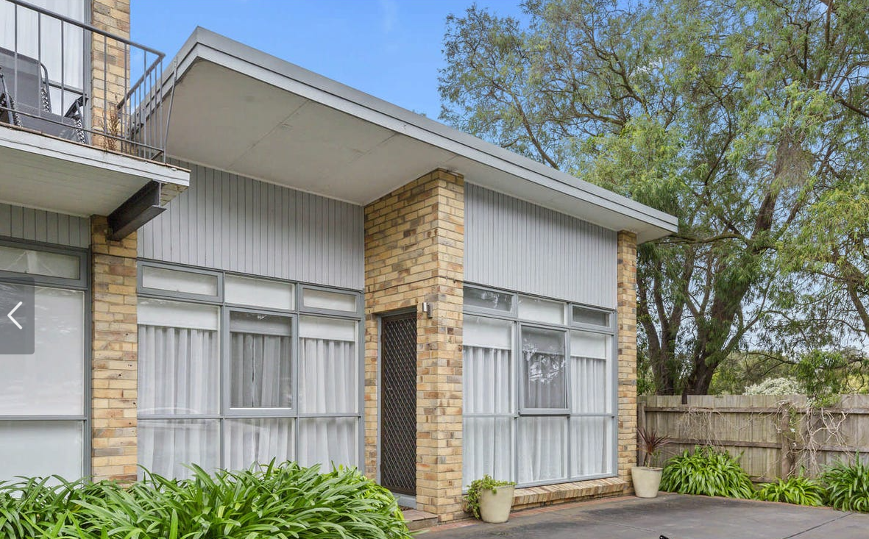
CCTV
Video Door Bell

Slide 3
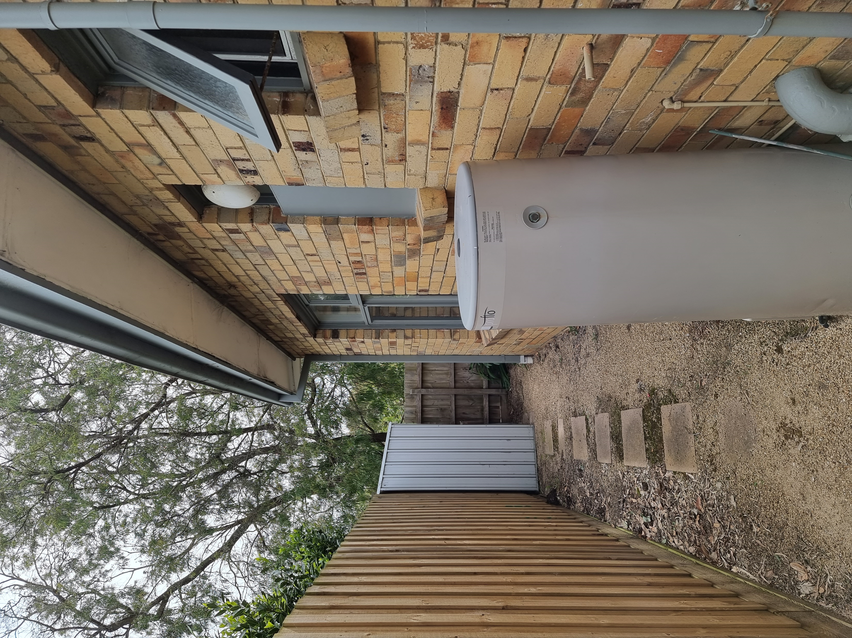
New Window
Location. Backfill infill with lining boards same as the front
Delete Window
Backfill with Bricks
Wall Mounted Outdoor Split System Unit
CCTV
New door
New Window
Location

Slide 4
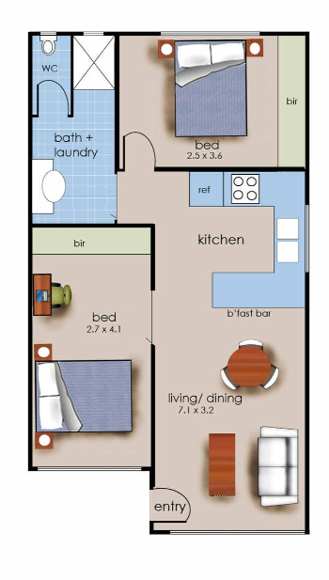
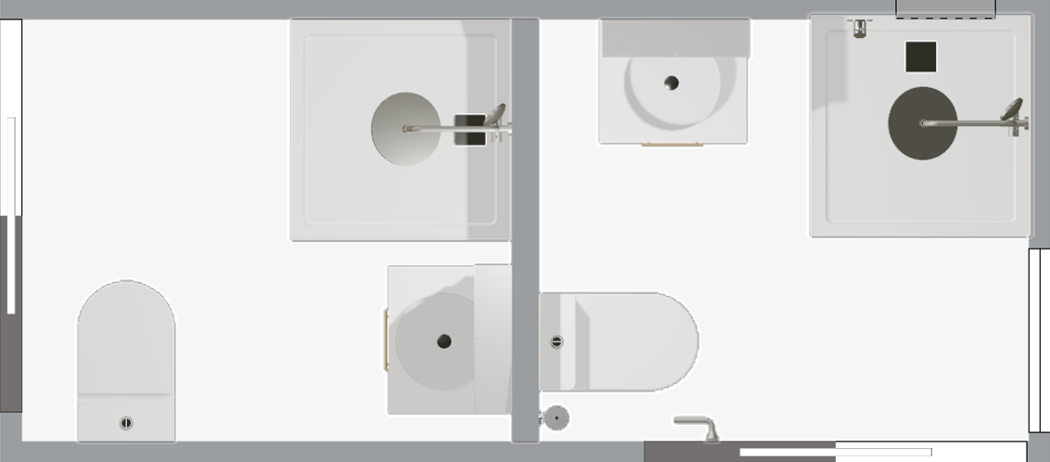
Proposed Floor Layout
870 x 1275 velux skylight
New Window
Euro
600 Pantry
E
Euro Laundry 2 x cupboard doors
Split system Back to Back
New Door
New Window

Slide 5
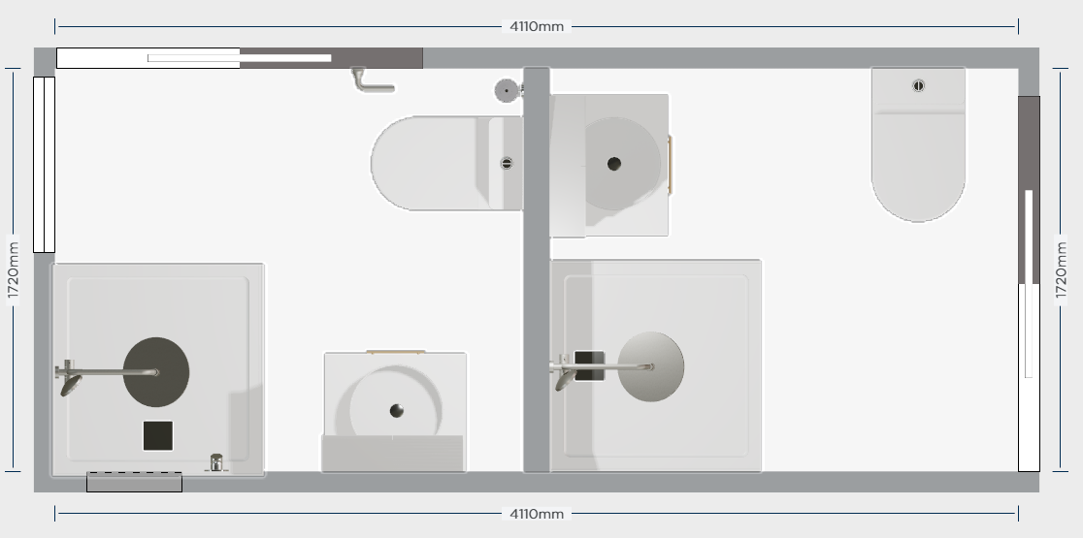

Slide 6
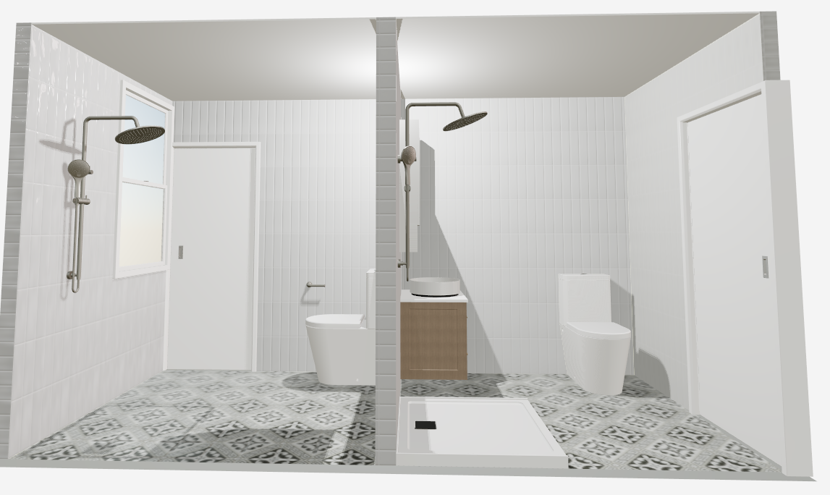

Slide 7
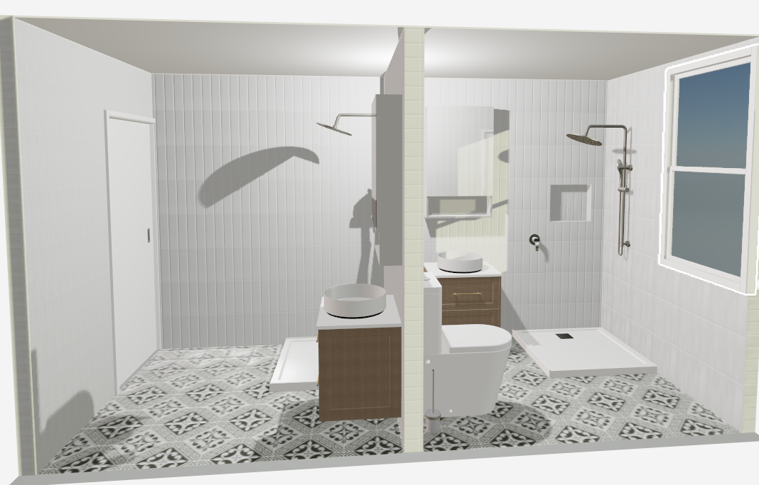

Slide 8
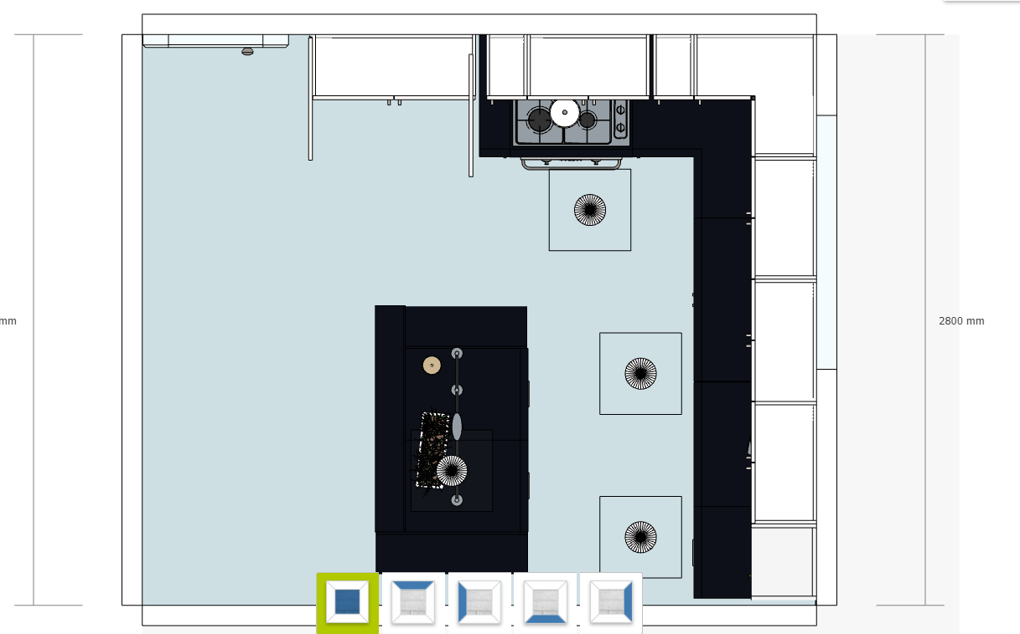

Slide 9
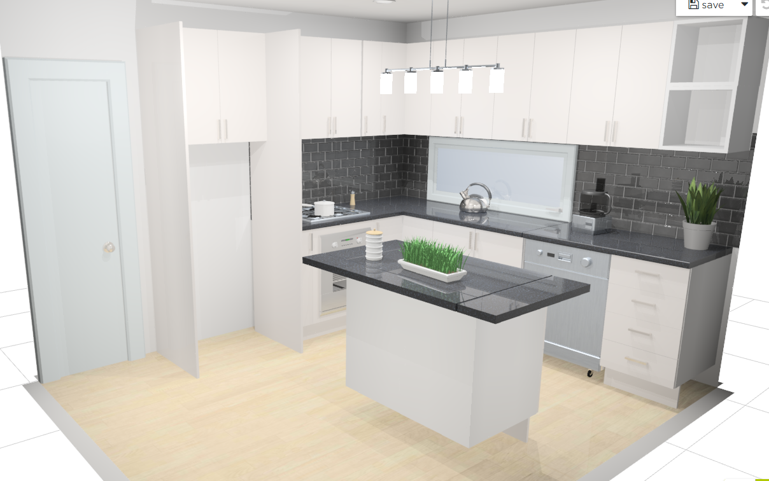

Slide 10
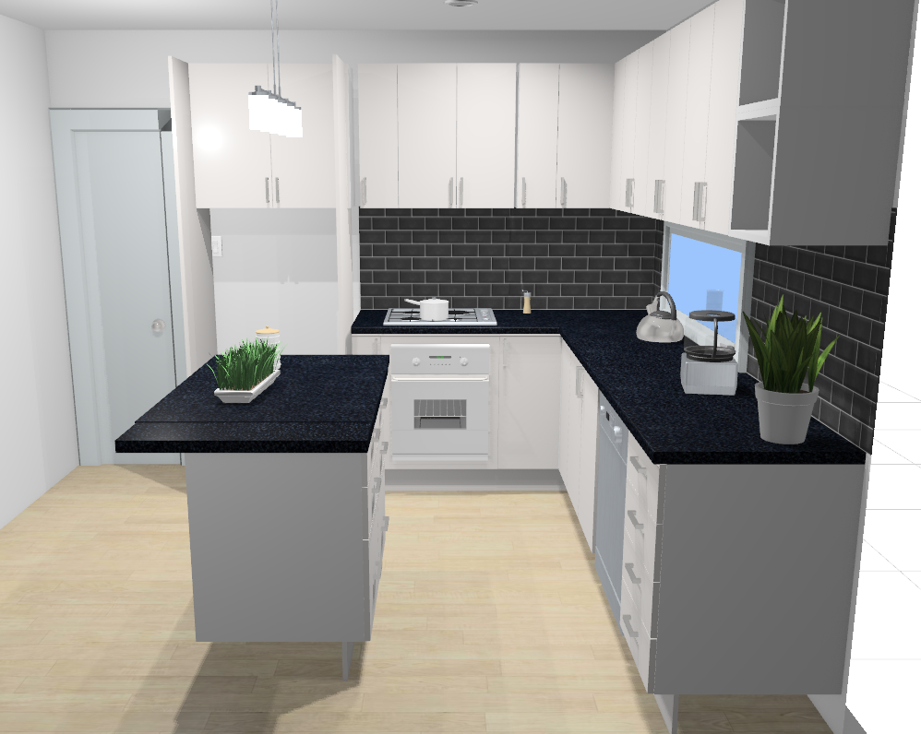

Slide 11
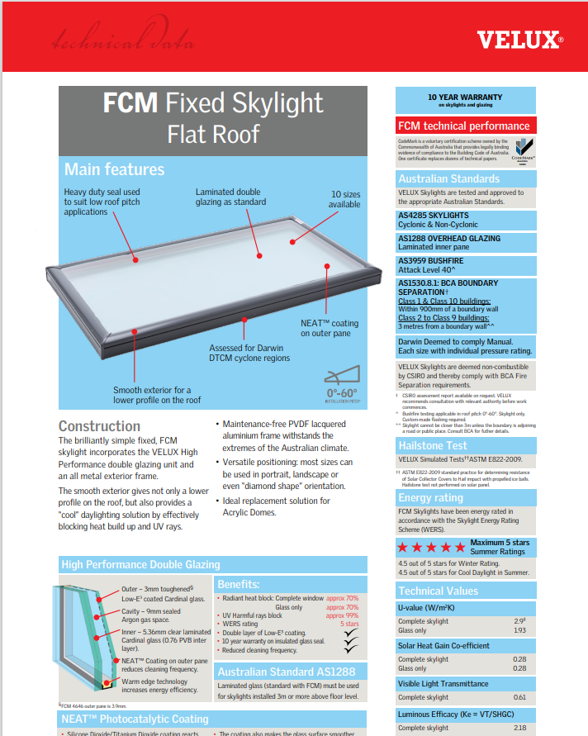
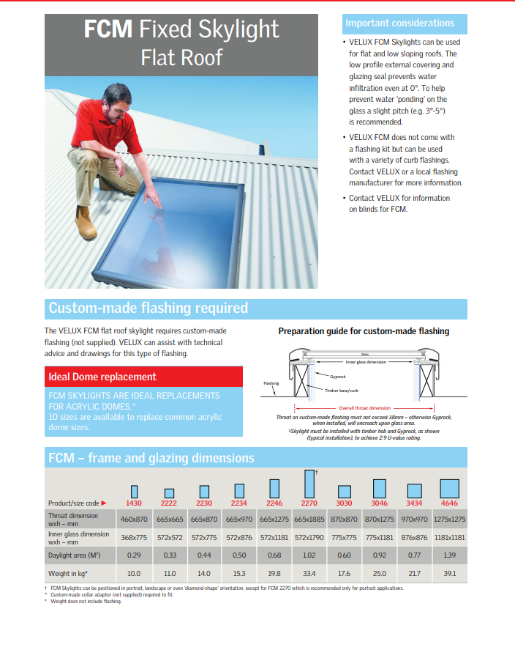

Slide 12
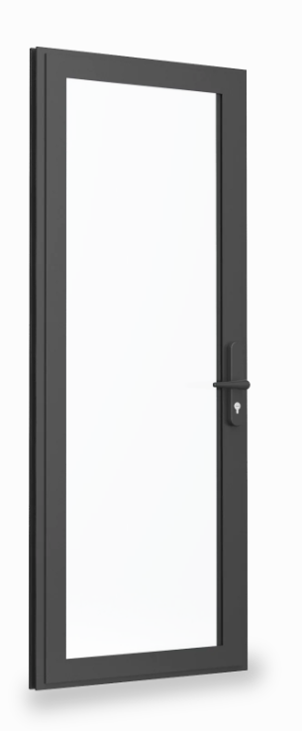
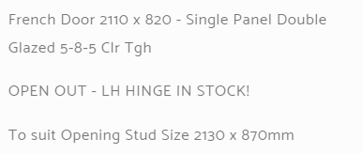

Slide 13
Current

Slide 14
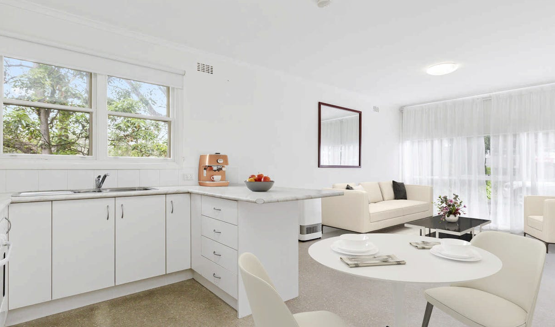

Slide 15
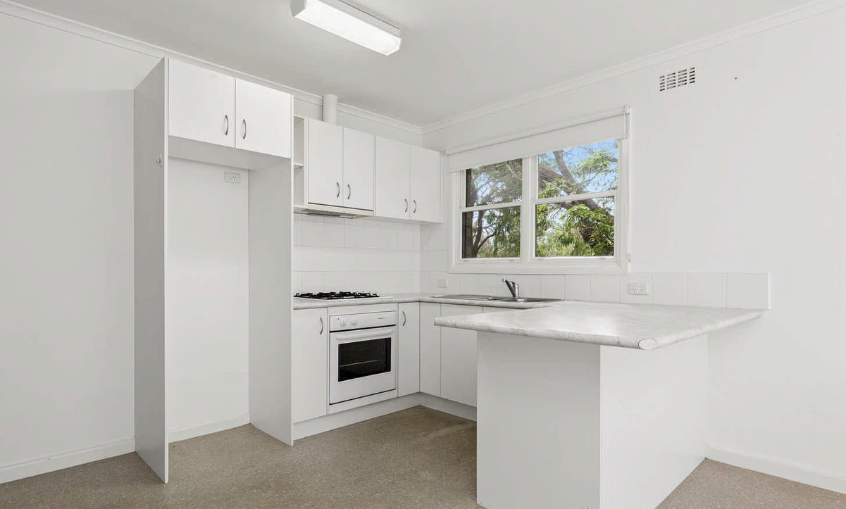

Slide 16
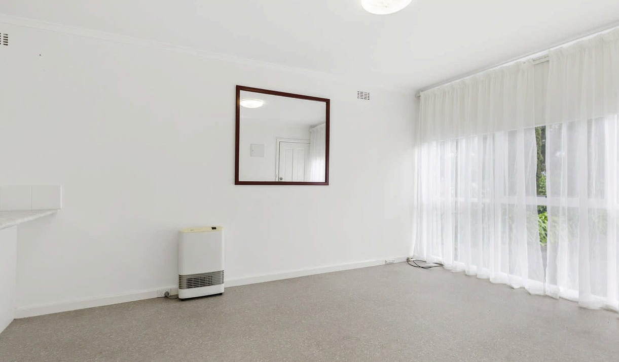

Slide 17
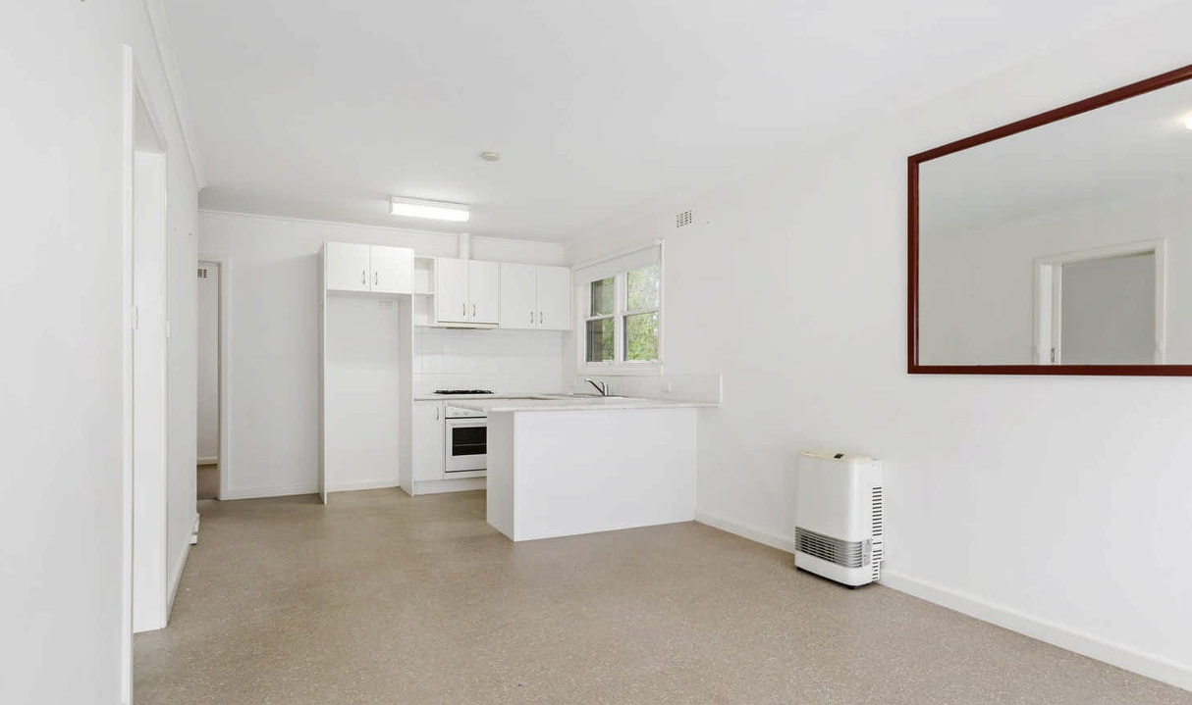

Slide 18
